Slide 1
Vanderbilt University Medical Center: Elective Surgery Schedule
Presented By:
Sheethal Sridhar

Slide 2
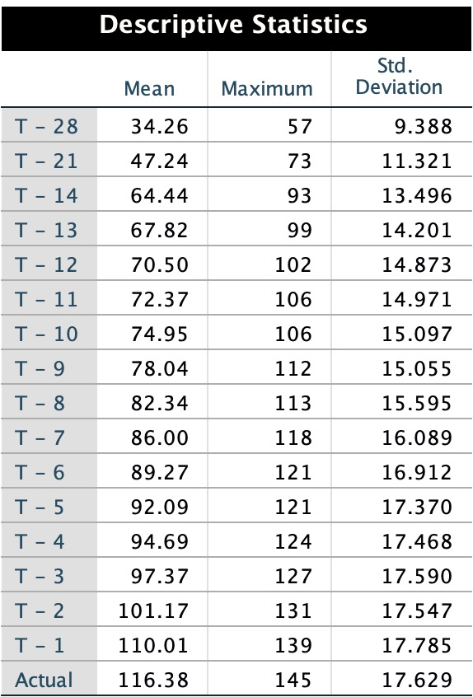
Exploratory Analysis
The table shows the Mean, Maximum, Std. Deviation and Variance of actual surgeries and number of cases scheduled prior to surgery for 48 weeks
Average of actual surgery is 116 with standard deviation of 17.63
Also average number of surgery cases increases as we move closer to actual day

Slide 3
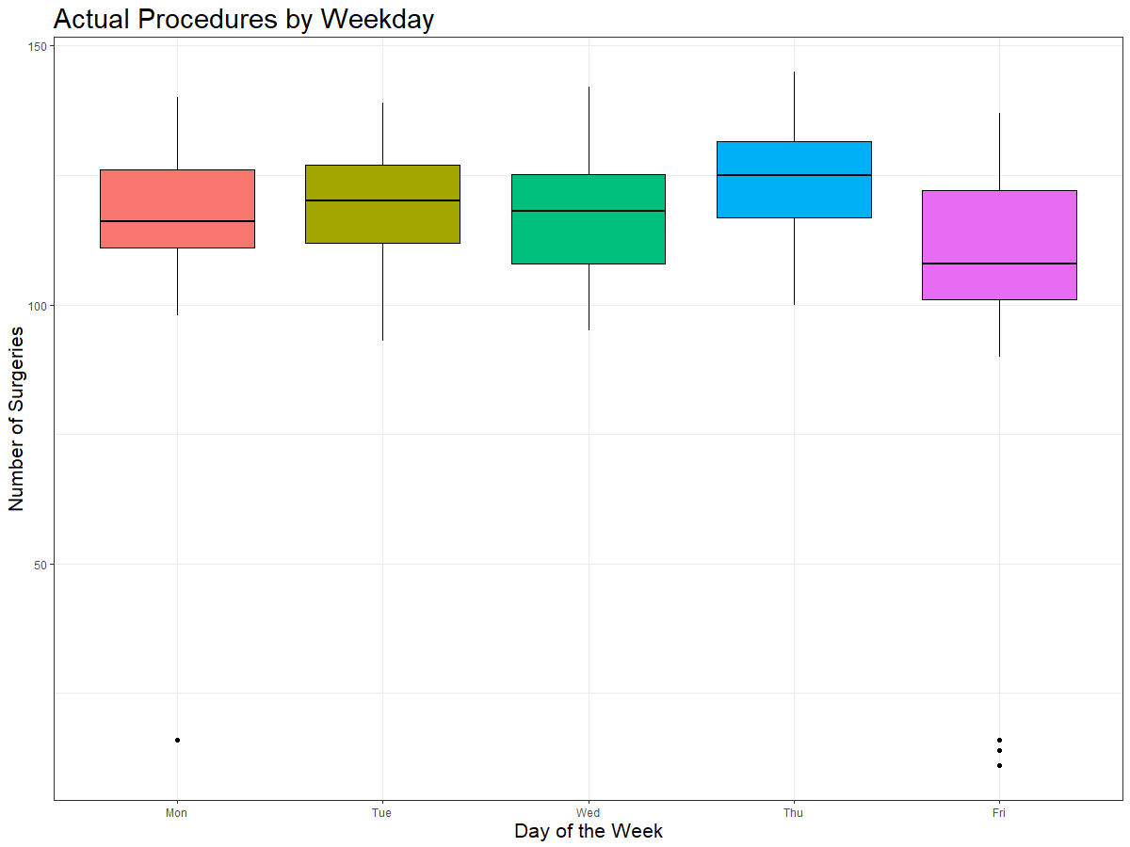
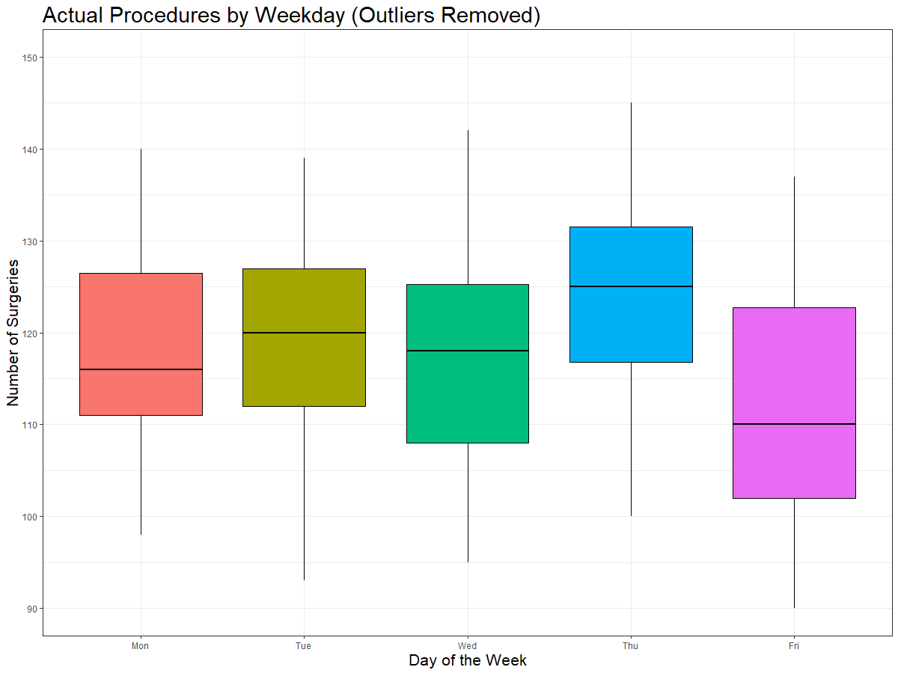
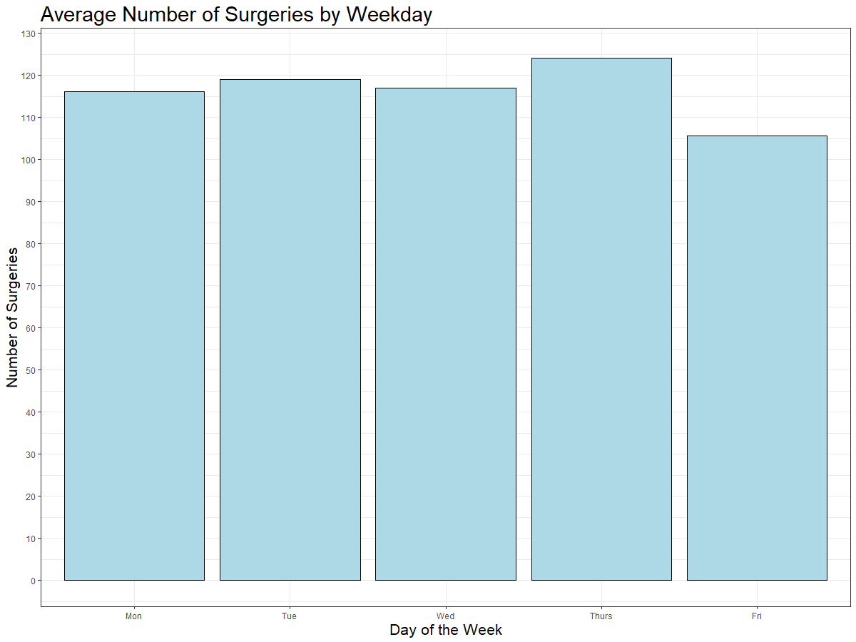
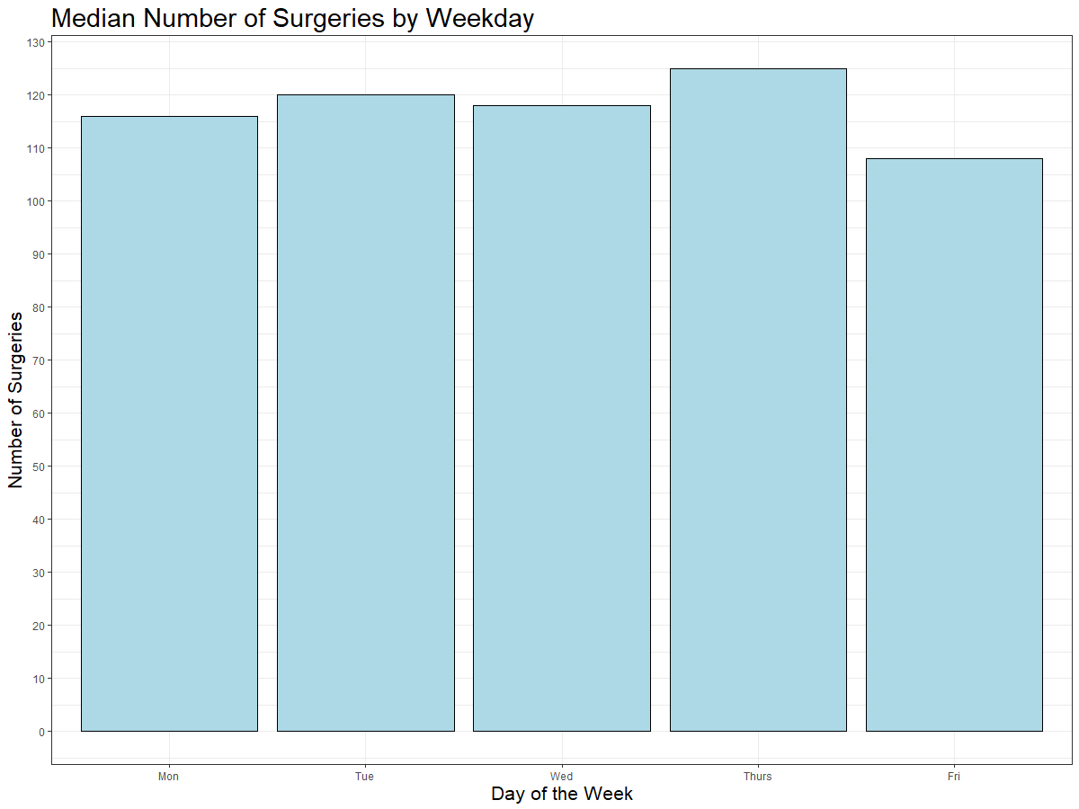
Exploratory Analysis - Day of Week

Slide 4
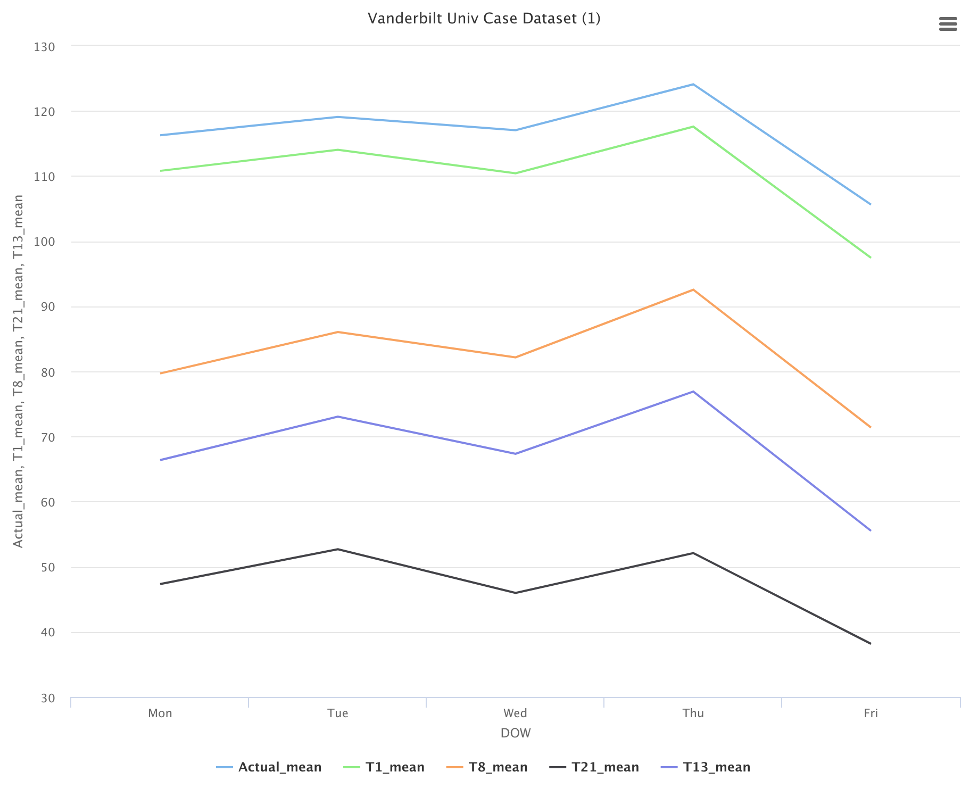
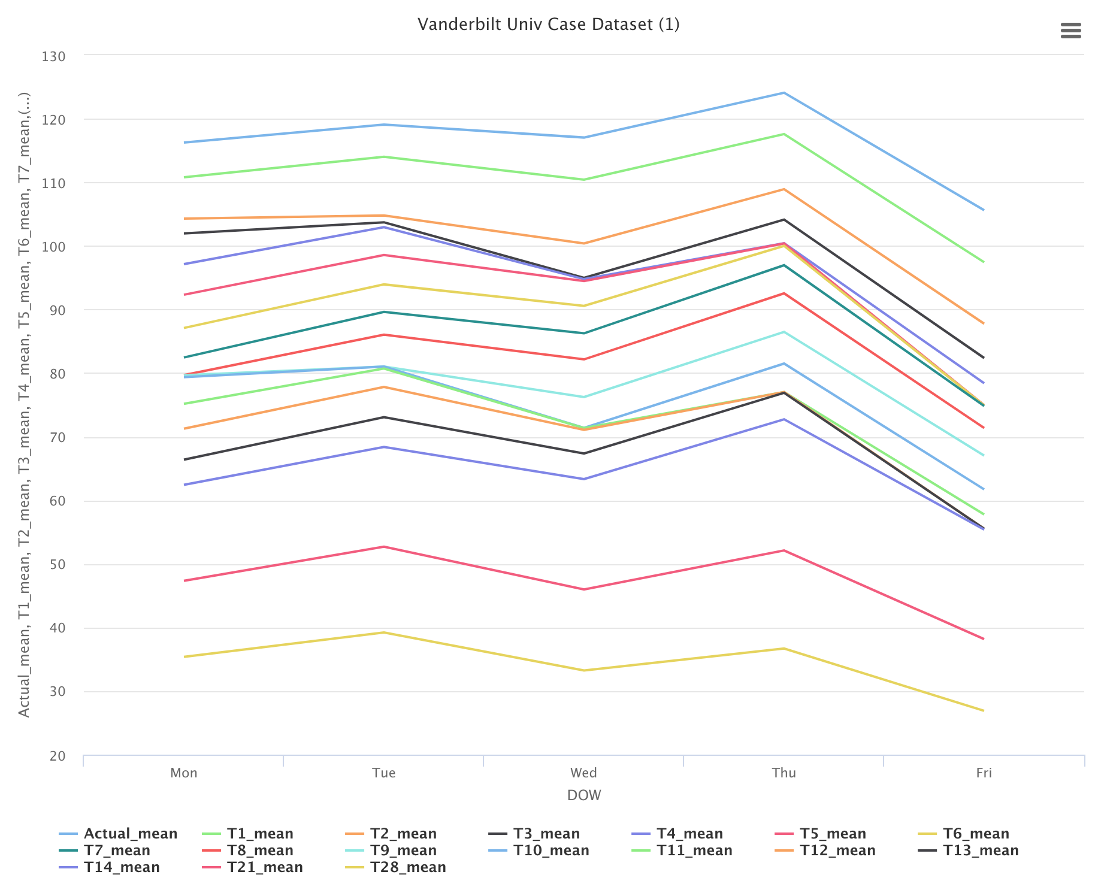
Exploratory Analysis - Day of Week
From the plots we can see how the total surgical case volume differs based on the day of week
Maximum on Thursday and Friday the lowest

Slide 5
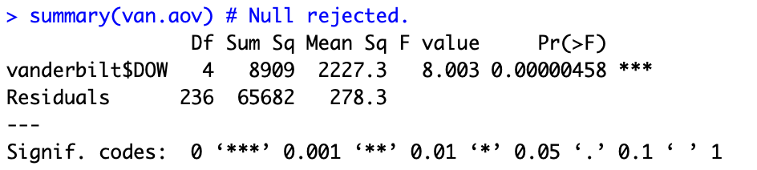
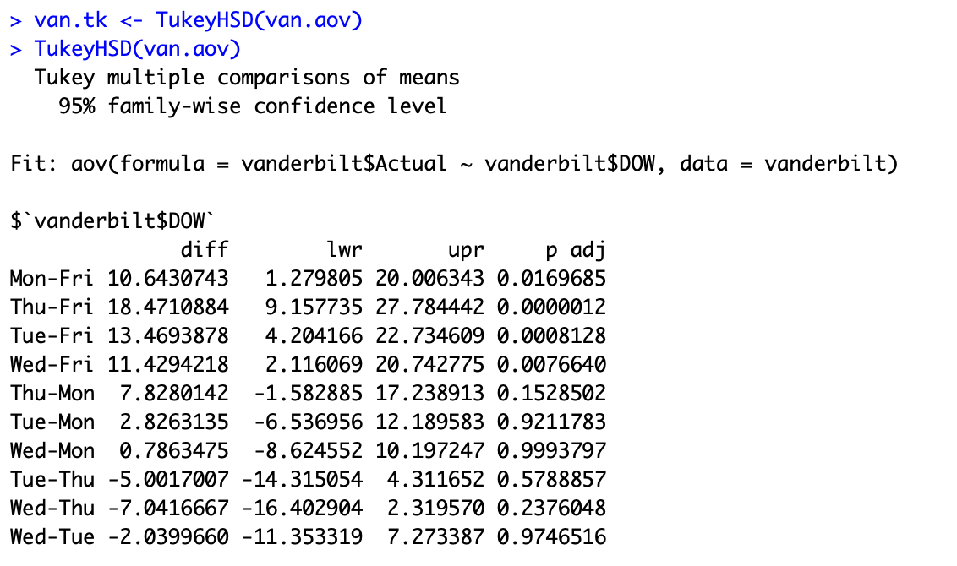
ANOVA Test
Null Hypothesis: Total surgical case volume does not differ based on the day of week
Alternative Hypothesis: Total surgical case volume differs based on the day of week
By ANOVA test result we can reject our null hypothesis with 99% confidence
Hence there is a difference in total surgical case volume based on day of week
Tukey test results provides the differences between every pair(any two days)

Slide 6
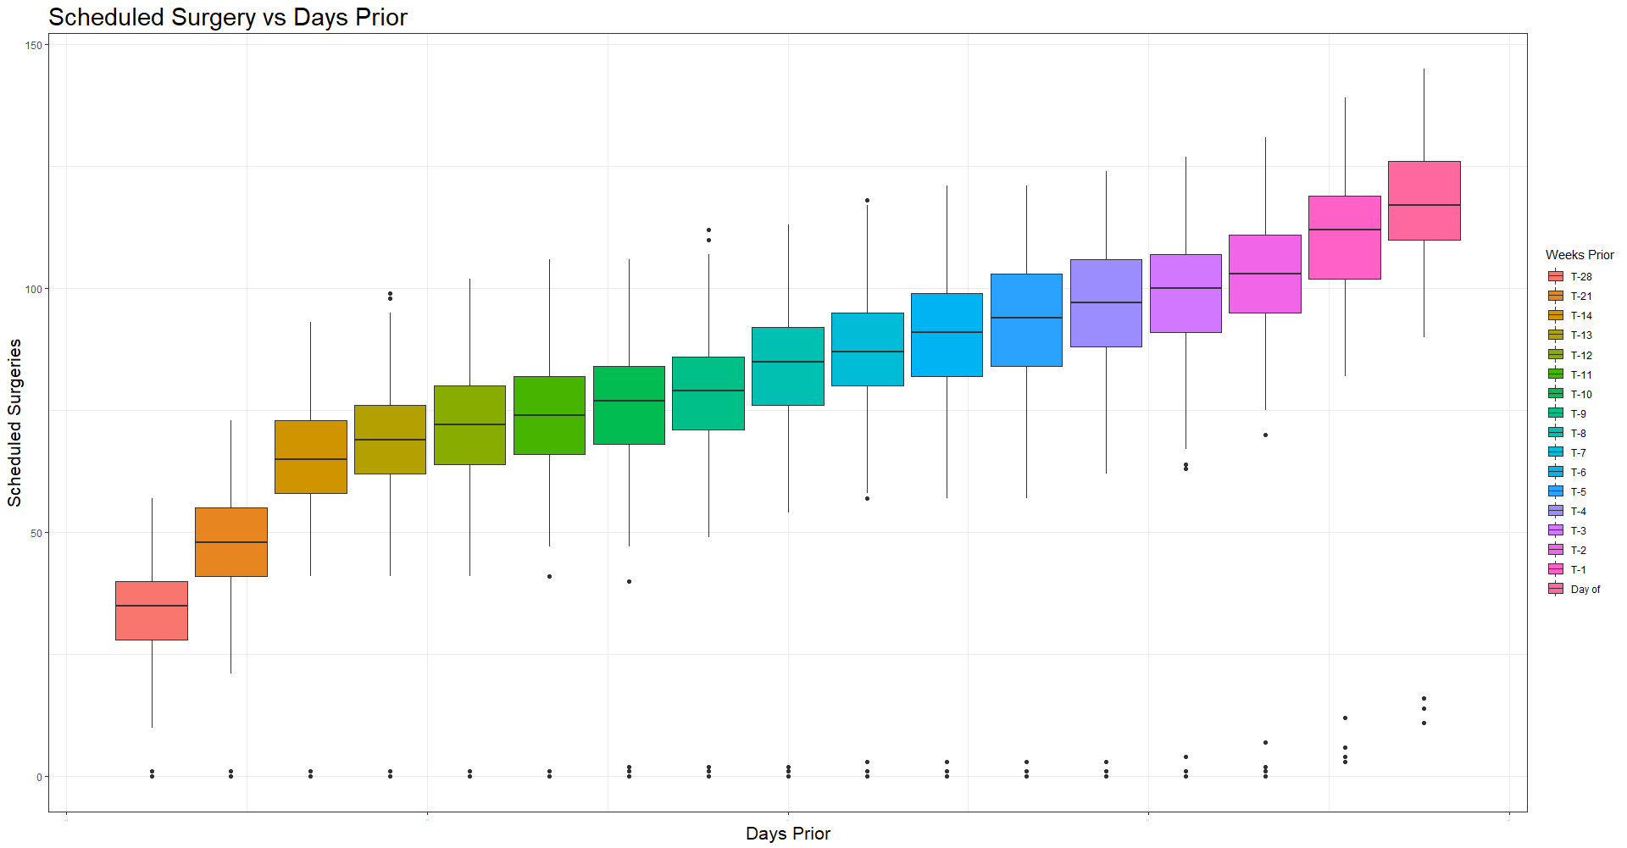
Exploratory Analysis - Scheduled Surgeries

Slide 7
Model - Two approaches
1. Regression:
Linear Regression
2. Time Series:
Simple Moving Average
Dependent variable - Actual Surgery
Independent variables - DOW, T28 to T4
We are not considering last 3 days for our model building:
Business: Want to know actual surgery few days before actual day
Technical: Last 3 days will be highly correlated with actual surgery

Slide 8
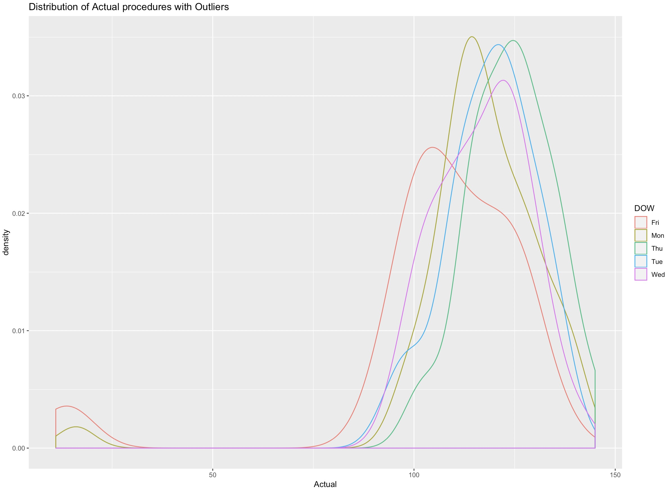
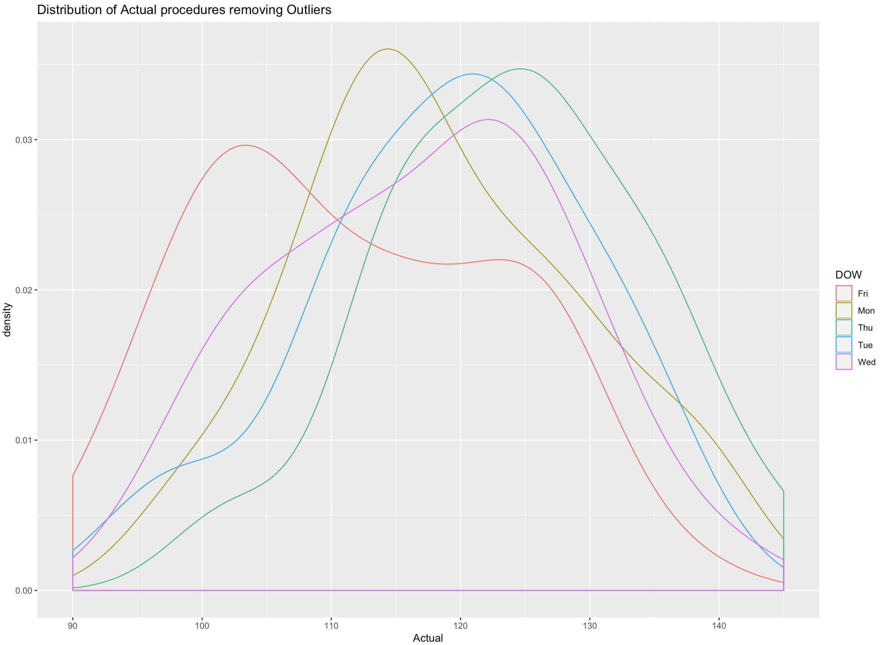
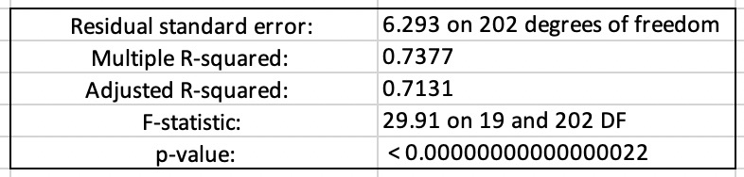
Linear Regression
Analysing our dependent variable
Removed outliers, so that dependent variable is uniformly distributed
The model explains the variance by 71.31%
Average Daily Error: ~4 Surgeries

Slide 9
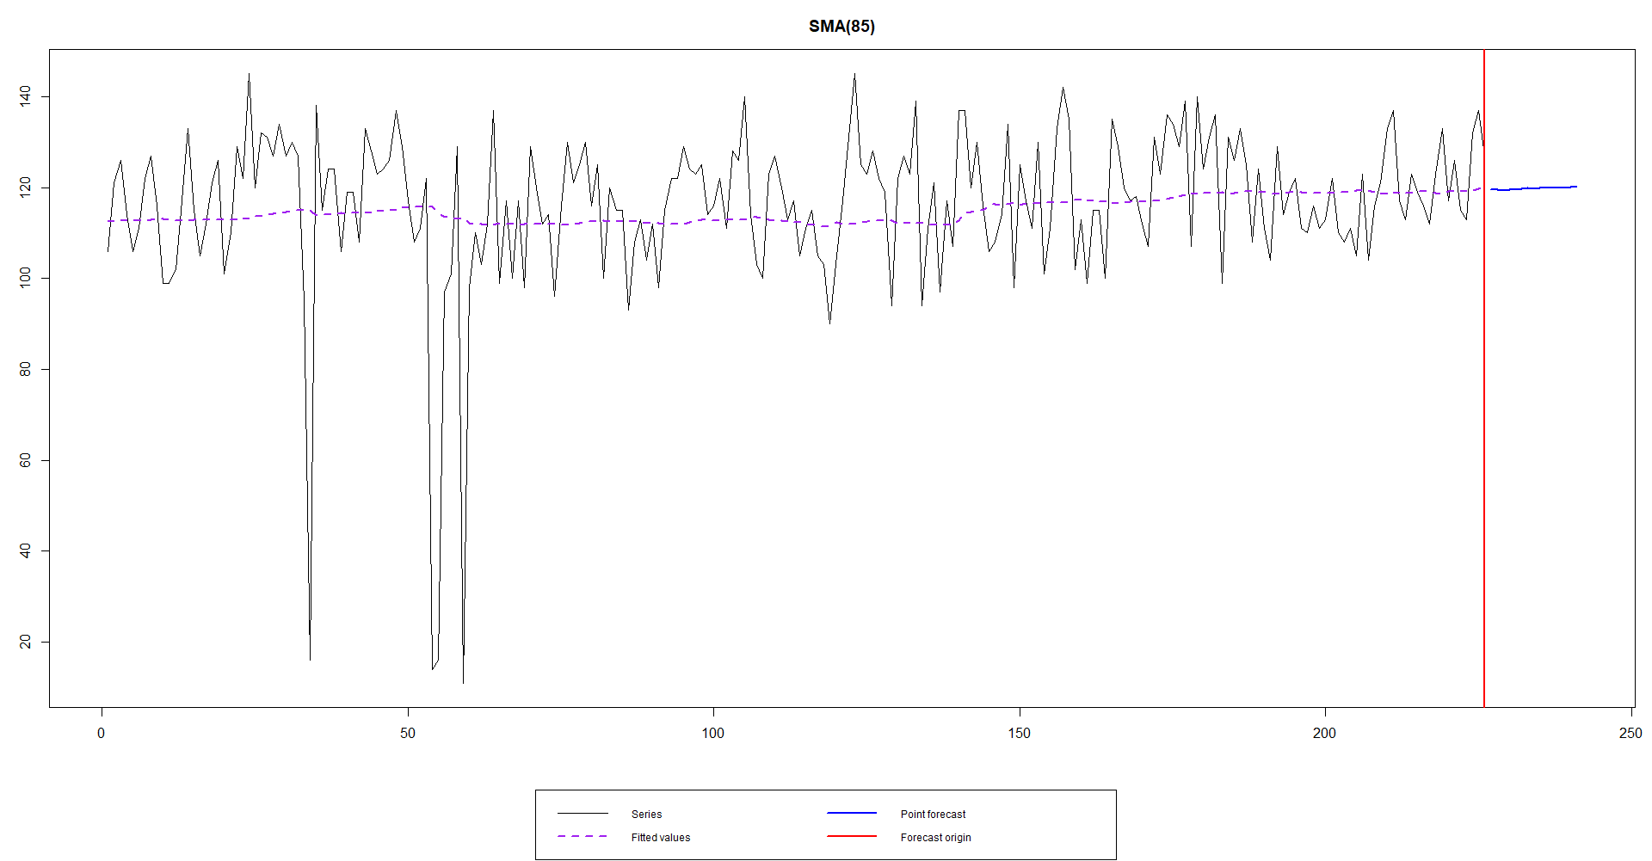
2. Simple Moving Average
Ran a Simple Moving Average Forecast for the next 15 days
Introduced a bias added or subtracted from the SMA forecasted based on the day of the week for each days results
Average Daily Error: ~8 Surgeries

Slide 10
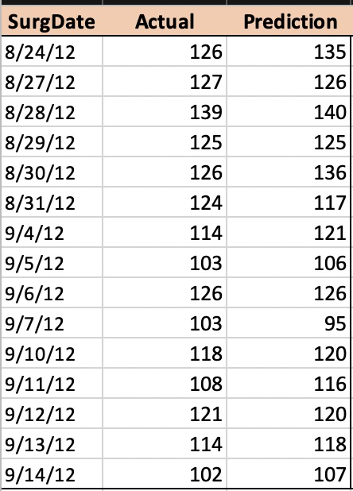
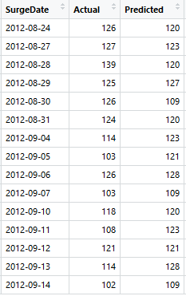
Prediction on final 3 weeks
Approach 1 - Linear regression output | Approach 2 - SMA output

Slide 11
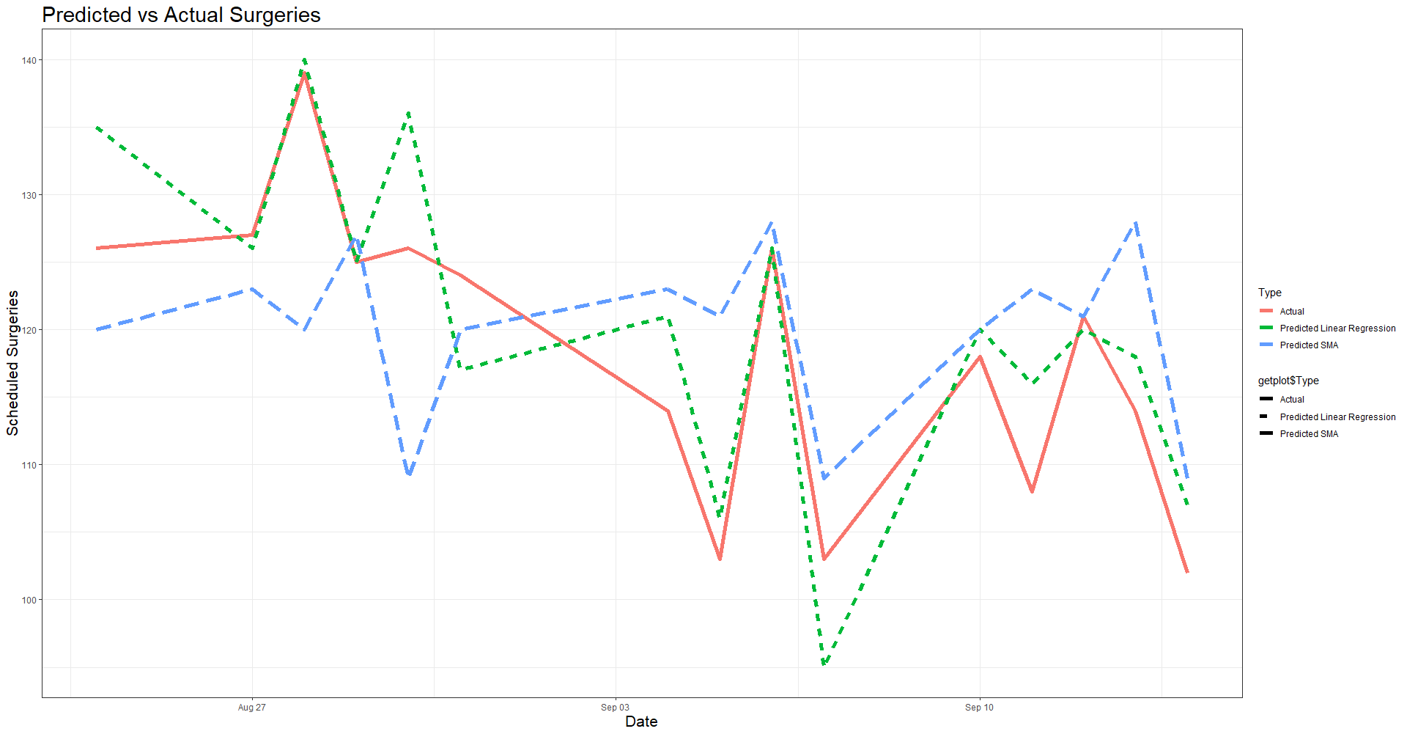
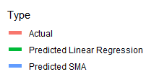
Prediction on final 3 weeks

Slide 12
Prediction on final 3 weeks
 | Approach 1 Linear regression | Approach 2 SMA
Sum of Surgery forecast : Actual Surgery : Total 15 Day Error: Error Percentage: | 1808 1776 32 1.77% | 1801 1776 25 1.41%

Slide 13
Thank You

